Slide 1
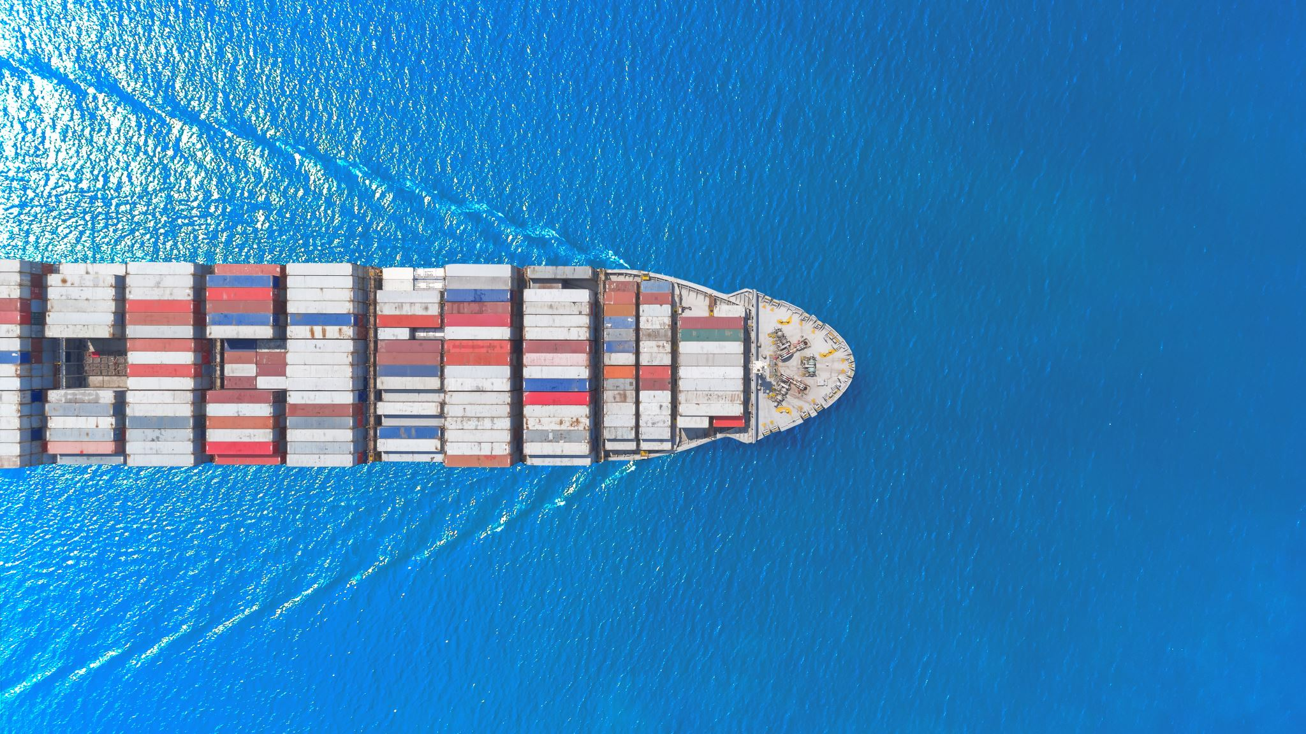
REAL VESSEL DATA Challenge
A first of a kind Workshop on Modelling, Insights and Actionable Outcome

Slide 2
AIMS
Support Open Science Practices
Foster Innovation in Data Analysis
Encourage Peer Learning and Networking
Encourage Continuous Improvement
Facilitate Open Dialogue on Challenges
Encourage Feedback for Improvement

Slide 3
CHALLENGES
Baseline model identification
  Current condition
  Uncertainty Estimation
  Fouling estimation
    Distinguish hull from propeller
Generalization
  Single ship
  Same type of ship (different sizes)
  Across Types of Ships
Data Quality Challenges
  Noise
  Data gaps
  Miscalibration / sensor drifting
  Errors in weather

Slide 4
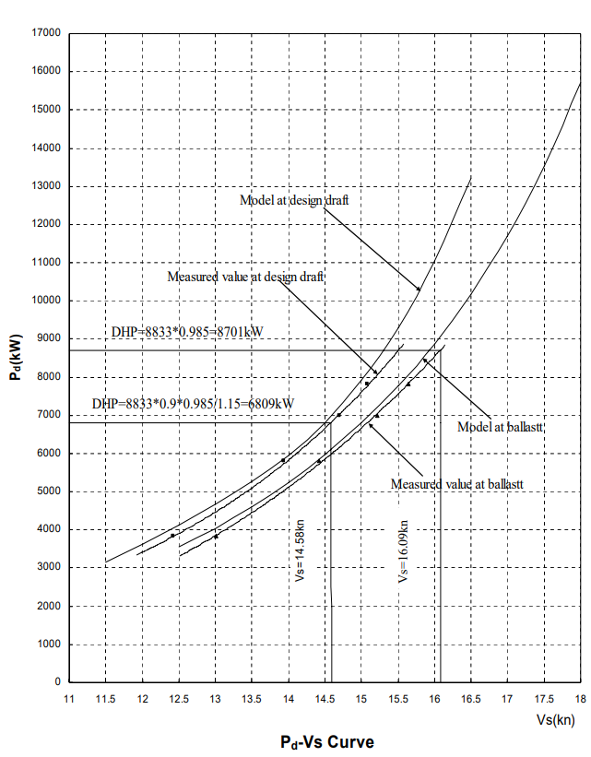
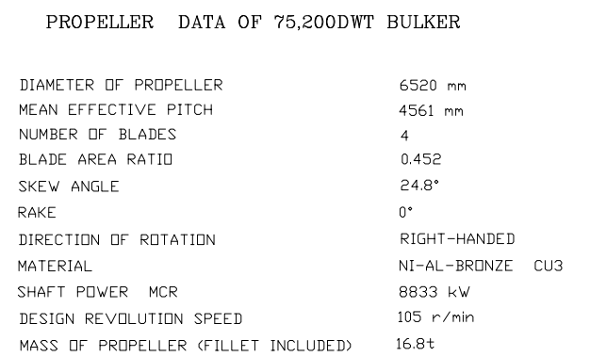
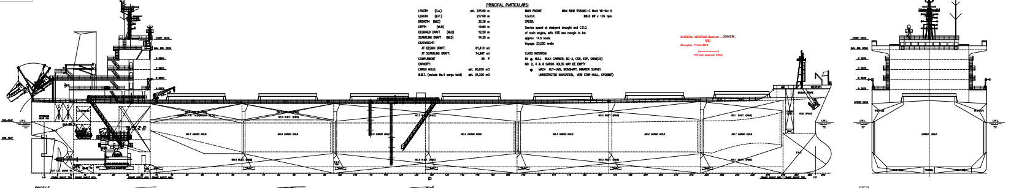
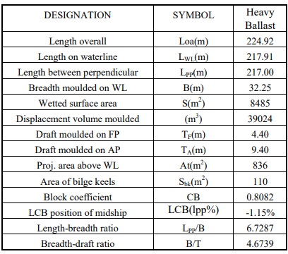
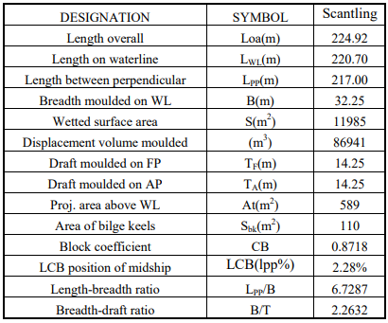
Bulk Carrier “Kanenas”
Anonymized GA
Data Shared:
Ship Particulars
Basic Propeller Data
Curves from Sea Trials
Ship has PSV installed

Slide 5
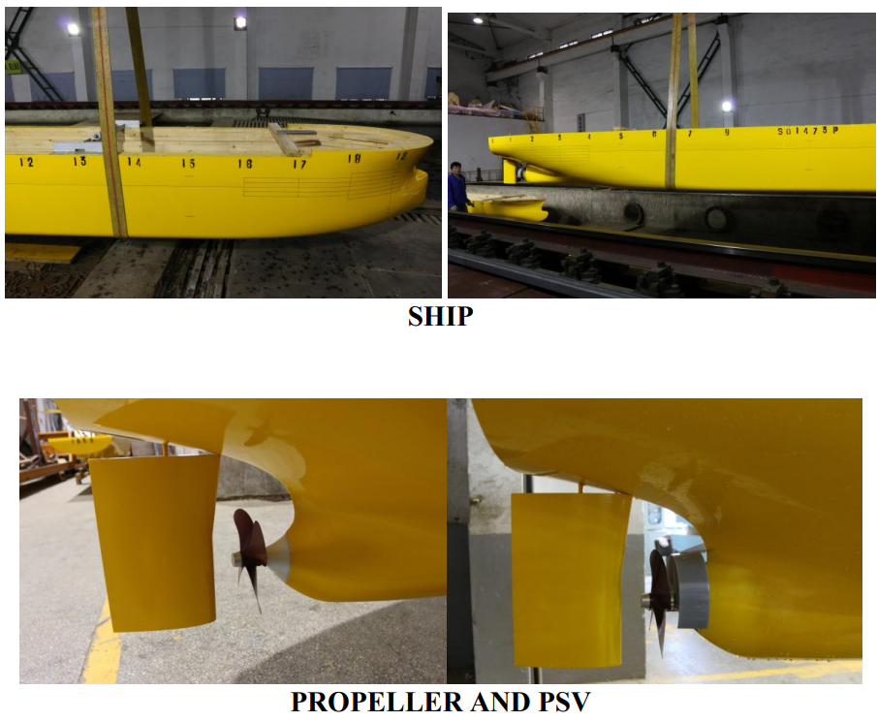
Bulk Carrier “Kanenas”
Data Not Shared:

Slide 6
DATASET
noon Reports
Cleaning Events
4/5 of the dataset will be RAW DATA
signified periods will contain “extra challenges”
TIME SERIES (.csv)
Vessel Hull Aft Draft | Control Alarm Monitoring System | m
Vessel Hull Fore Draft | Control Alarm Monitoring System | m
Main Engine Rotational Speed | Control Alarm Monitoring System | rpm
Vessel Hull MidP Draft | Control Alarm Monitoring System | m
Vessel Hull MidS Draft | Control Alarm Monitoring System | m
Vessel External Conditions Wind Relative Speed | Instrument Anemometer | knots
Vessel External Conditions Wind Relative Angle | Instrument Anemometer | degrees
Vessel Hull Relative To Transducer Water Depth | Instrument Echosounder | m
Vessel Hull Over Ground Speed | Instrument GPS 1 | knots
Vessel Hull Heading Turn Rate | Instrument Gyrocompass | deg/min
Vessel Hull Heading True Angle | Instrument Gyrocompass | degrees
Main Engine Turbocharger Rotational Speed | Instrument RPM Indicator | rpm
Vessel Hull Through Water Longitudinal Speed | Instrument Speedlog | knots
Vessel External Conditions Wave Significant Height | Provider MB | m
Vessel External Conditions Wind True Angle | Provider MB | degrees
Vessel External Conditions Swell Significant Height | Provider MB | m
Vessel External Conditions Wind True Speed | Provider MB | knots
Vessel External Conditions Wave Significant Height | Provider S | m
Vessel External Conditions Wave True Angle | Provider S | degrees
Vessel External Conditions Wave Period | Provider S | sec
Vessel External Conditions Sea Water Temperature | Provider S | Â°C
Vessel External Conditions Northward Wind Velocity | Provider S | m/s
Vessel External Conditions Eastward Wind Velocity | Provider S | m/s
Main Engine Fuel Load % | Transducer Fuel Load | %
Main Engine Scavenging Air Pressure | Transducer Pressure | bar
Main Engine Turbocharger Rotational Speed | Transducer RPM | rpm
Main Engine Fuel Oil Inlet Mass Flow | Instrument Torquemeter | kg/hr
Vessel Propeller Shaft Mechanical Power | Instrument Torquemeter | KW
Vessel Propeller Shaft Rotational Speed | Instrument Torquemeter | rpm
Vessel Propeller Shaft Torque | Instrument Torquemeter | N*m
Vessel Propeller Shaft Thrust Force | Instrument Torquemeter | KN
Vessel Propeller Shaft Mechanical Energy | Instrument Torquemeter | KWh
Vessel Propeller Shaft Revolutions | Instrument Torquemeter

Slide 7
Results Format
Structured formats (specific tables or csv files)
Baseline Model (Speed vs Power Curves)
Fouling Estimation (Added Power or Speed Loss)
Current condition
Data Quality / Uncertainty Analysis
Distinguish Hull from Propeller
Open ended
Methodology
Open Discussion
Data quality (overall)

Slide 8
MAIN IDEA
Compare results of all participants and all methods
  Against each other
  Against baseline created from towing tank and CFD
Produce objective evaluations
Propose better methods / evaluation criteria

Slide 9
Evaluation Criteria
Accuracy
Trend Keeping
Robustness
More details/scoring, will be discussed with participants in open session after summer break.

Slide 10
What’s In it for YOU
BRAGGING RIGHTS!!
Participation in shaping the criteria and future challenges
A clear benchmark to score and compare methods
Future evolution may lead to curated datasets like in other analytics communities (which eventually led to the recent AI explosion..)

Slide 11
Key Dates
June 2 2025 Release of Data
July 2025 Participants Forum Launch
August 2025 Intermediate Participants meeting
December 2025 Submission Deadline for Analyses and Reports
February 2026 Compiling Workshop Results
March 2026 Workshop Presentation (HullPIC)
April 2026 Publication of Final Report

Slide 12
More Info
Website shipdatachallenge.com
Discord Channel TBA
Linkedin page TBA
https://forms.gle/kVFsoZoh4WMoWidf6

Slide 13
FUTURE CHALLENGES
Generalization (across size and across type)
Mixed quality datasets
ESDs, Wind Assistance, Air Lubrication
Community Input

Slide 14


